Slide 1
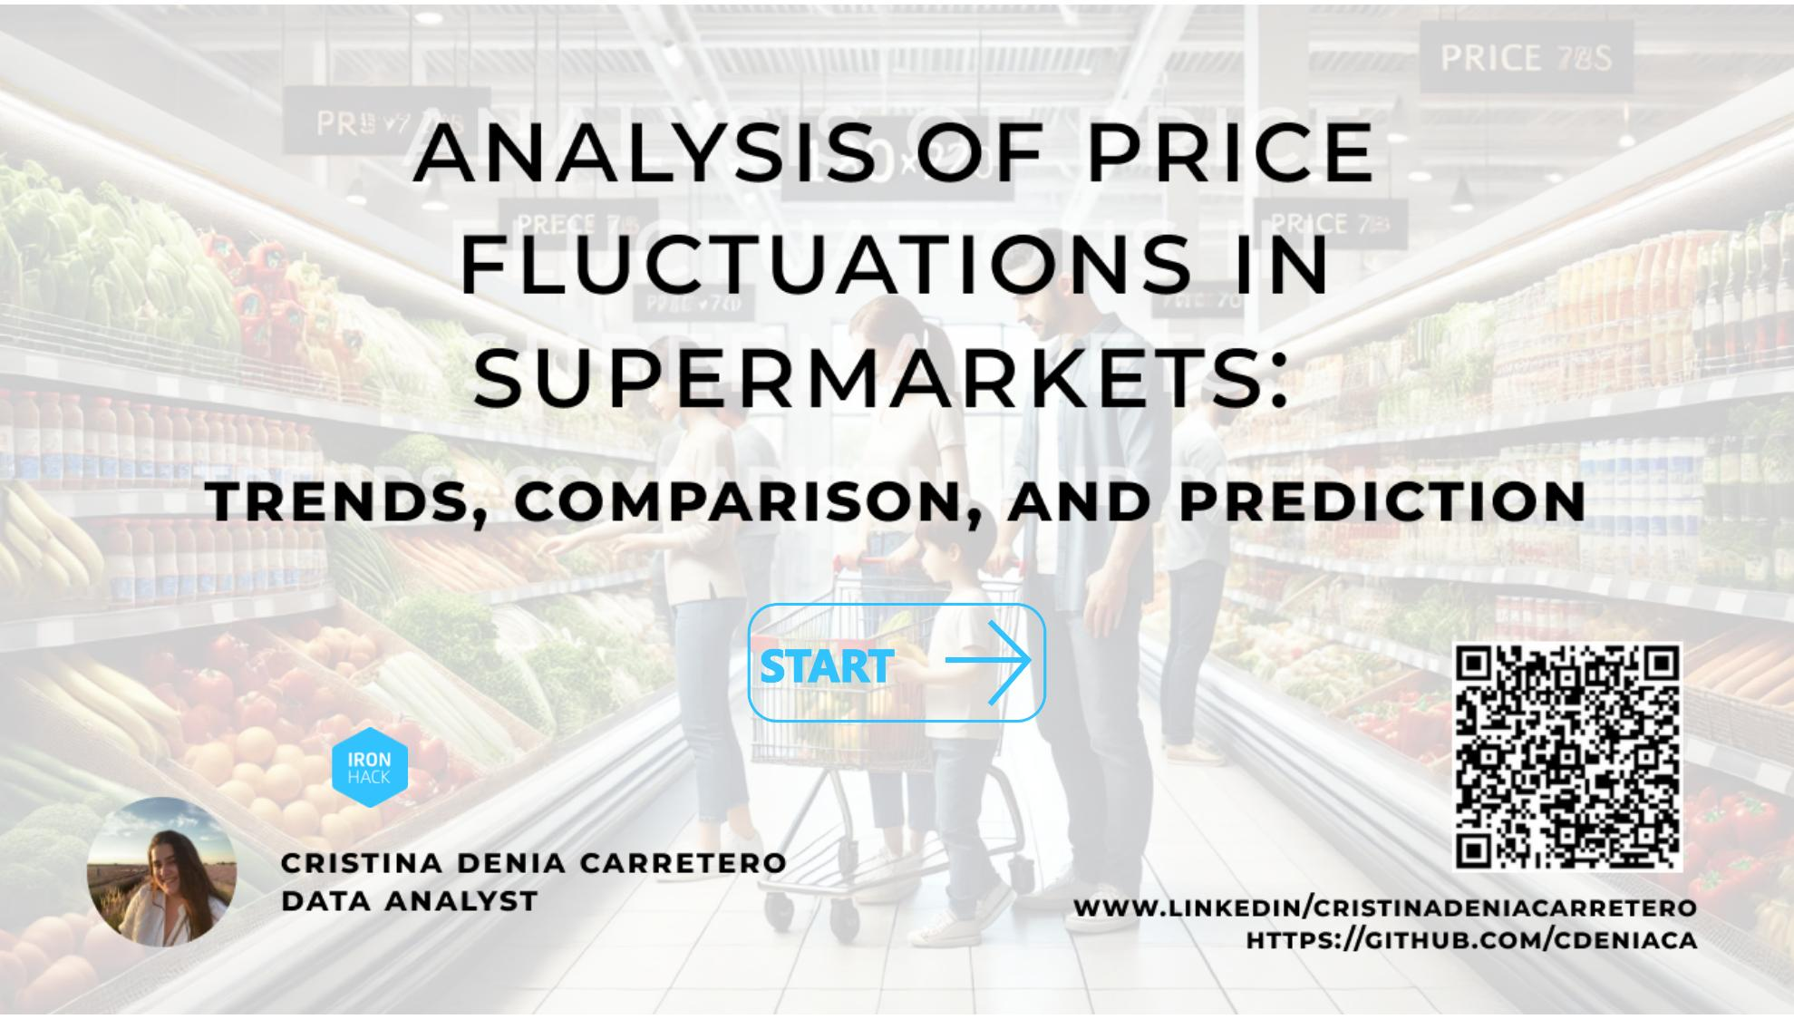
Main
Notes:
image
No alt text provided
actionButton
No alt text provided

Slide 2
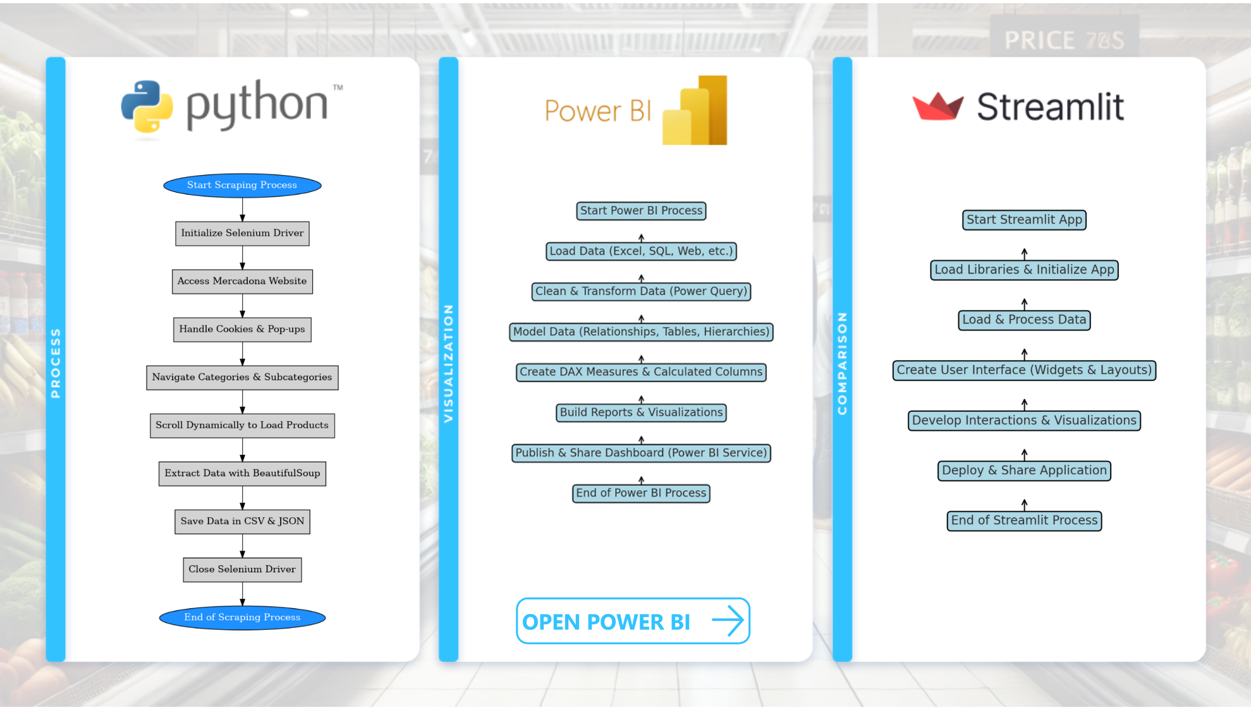
Introduction
Notes:
image
No alt text provided
actionButton
No alt text provided
image
No alt text provided
image
No alt text provided
actionButton
No alt text provided

Slide 3
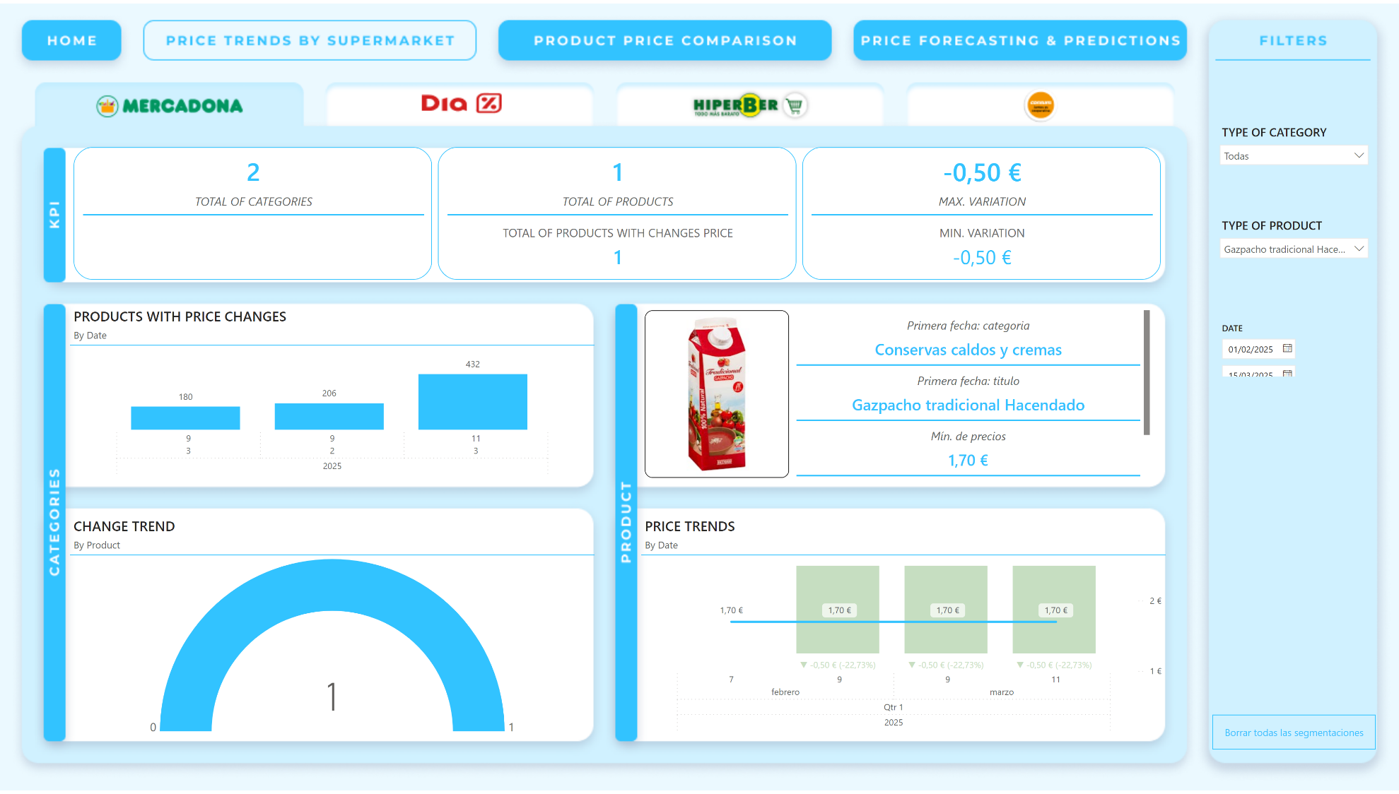
MERCADONA
Notes:
advancedSlicerVisual
No alt text provided
CHANGE TREND
No alt text provided
slicer
No alt text provided
slicer
No alt text provided
slicer
No alt text provided
PRODUCTS WITH PRICE CHANGES
No alt text provided
actionButton
No alt text provided
actionButton
No alt text provided
actionButton
No alt text provided
actionButton
No alt text provided
cardVisual
No alt text provided
actionButton
No alt text provided
PRICE TRENDS
No alt text provided
cardVisual
No alt text provided
actionButton
No alt text provided
actionButton
No alt text provided
actionButton
No alt text provided
actionButton
No alt text provided

Slide 4
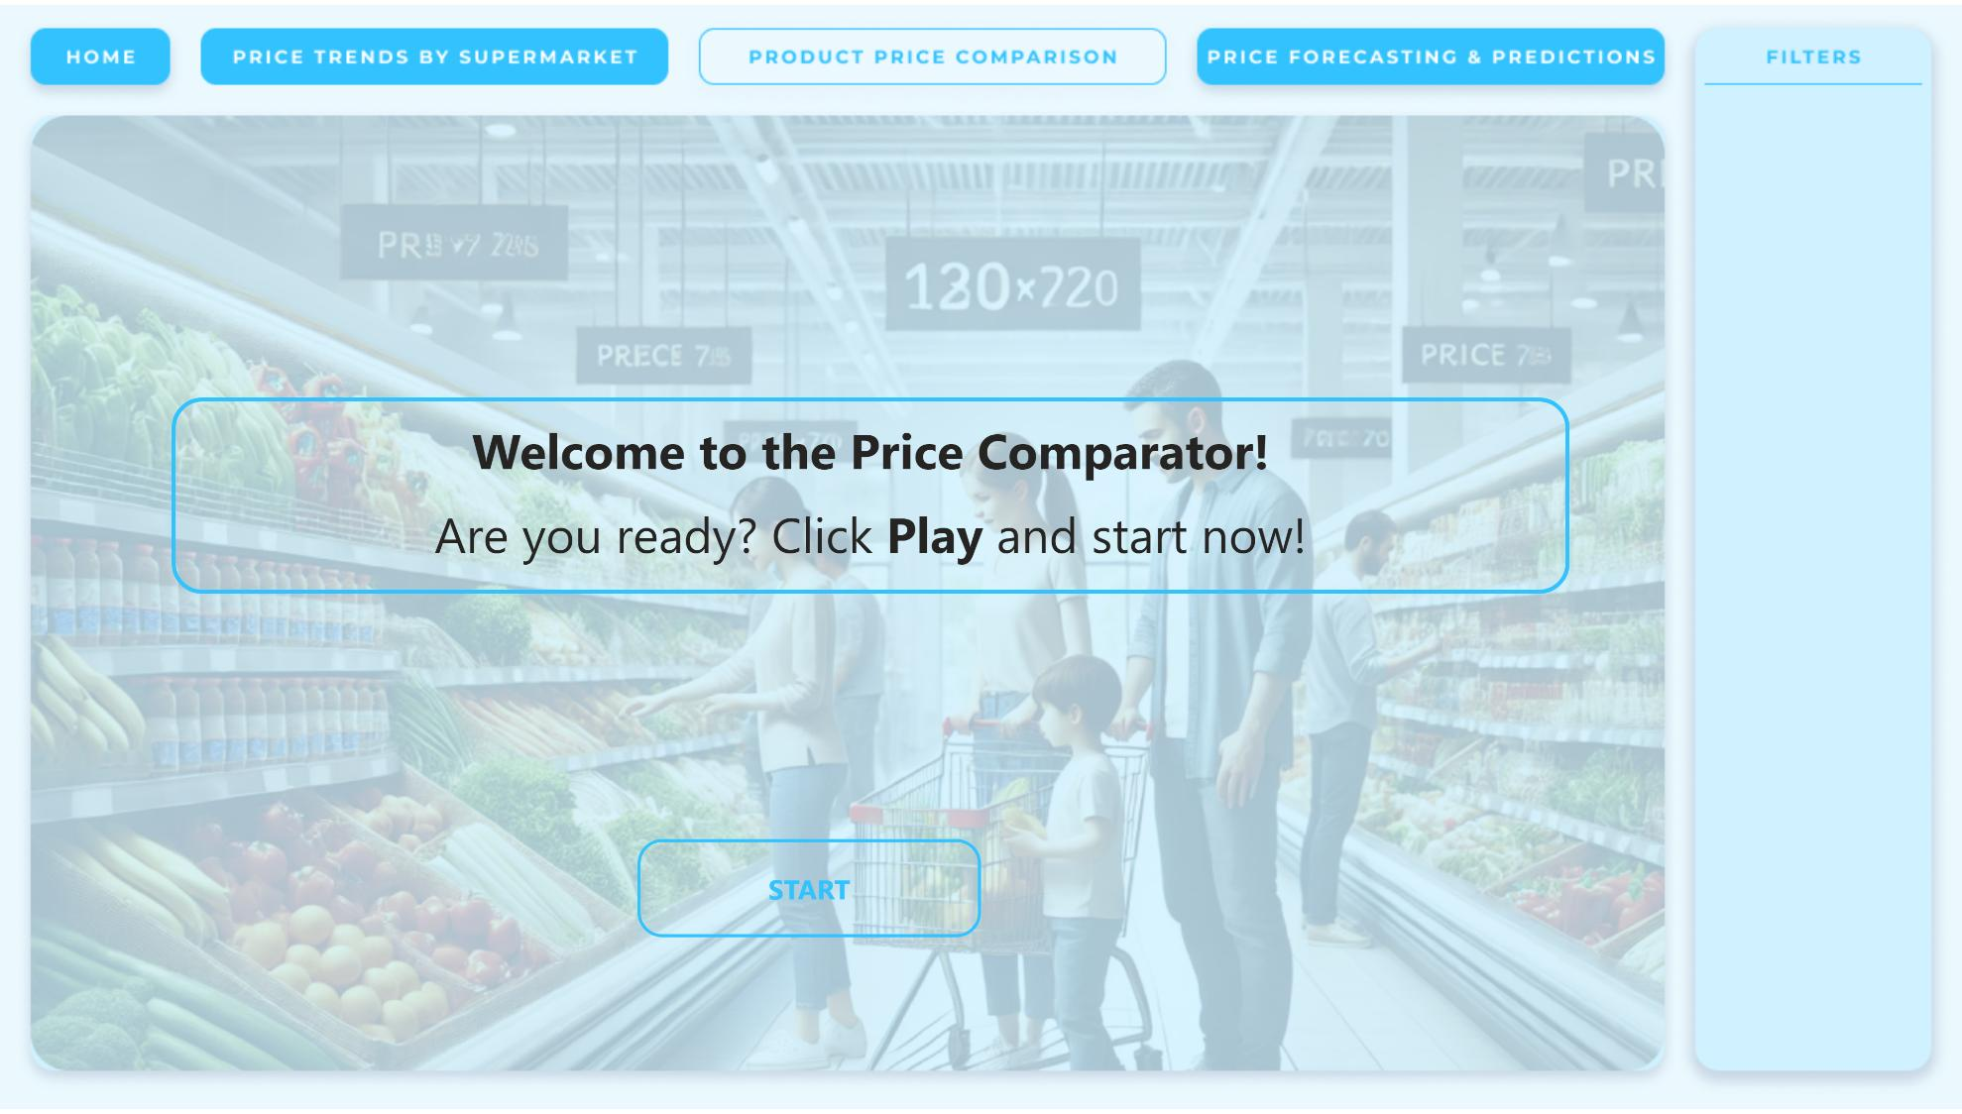
PRODUCT PRICE COMPARISON
Notes:
actionButton
No alt text provided
textbox
No alt text provided
actionButton
No alt text provided
actionButton
No alt text provided
actionButton
No alt text provided
actionButton
No alt text provided

Slide 5
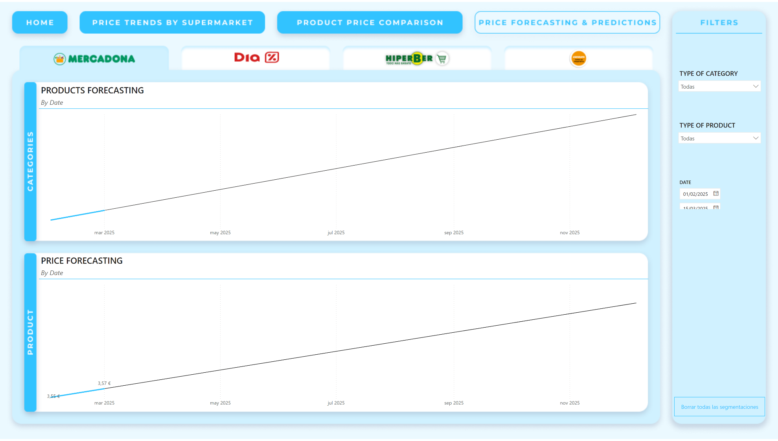
PRICE FORECASTING & PREDICTIONS
Notes:
actionButton
No alt text provided
actionButton
No alt text provided
actionButton
No alt text provided
actionButton
No alt text provided
actionButton
No alt text provided
slicer
No alt text provided
slicer
No alt text provided
slicer
No alt text provided
actionButton
No alt text provided
actionButton
No alt text provided
actionButton
No alt text provided
actionButton
No alt text provided
PRODUCTS FORECASTING
No alt text provided
PRICE FORECASTING
No alt text provided

Slide 6

End
Notes:
actionButton
No alt text provided
image
No alt text provided

